Slide 1


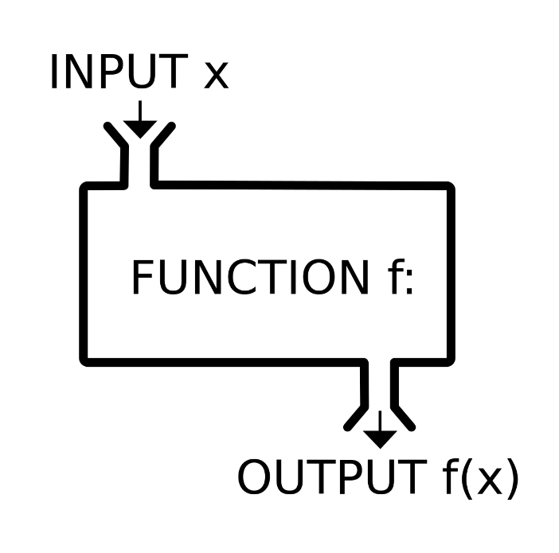
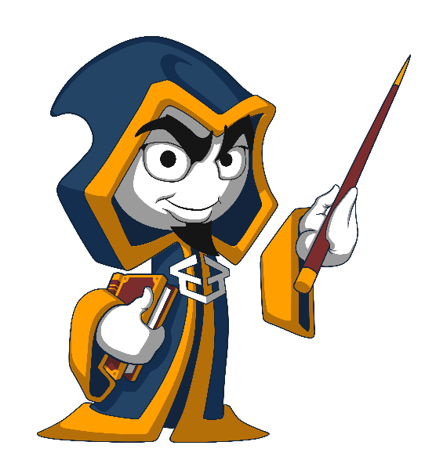

Function, Debugging and Troubleshooting Code
Defining and Using Functions, Overloads, Debugging
Functions
SoftUni Team
Technical Trainers
Software University
http://softuni.bg

Slide 2


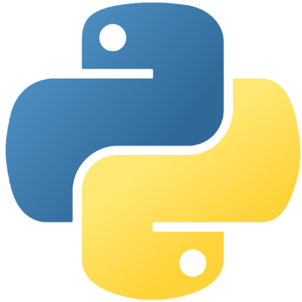
Table of Contents
Using Functions
What is a Function? Why Use Functions?
Declaring and Invoking Functions
Functions with Parameters
Passing Parameters and Returning Values
Debugging and Program Flow
Naming and Best Practices

Slide 3
Questions?
sli.do #python-fund

Slide 4
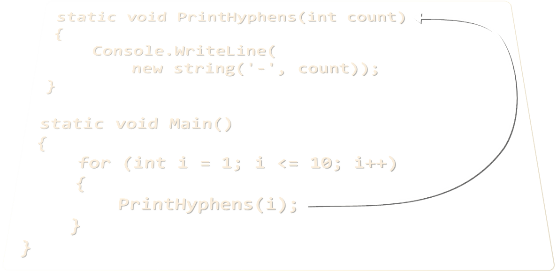
Declaring and Invoking Functions

Slide 5
Simple Functions
Functions are named pieces of code that can be invoked later
Sample function definition:
Invoking (calling) the function several times:
Function named print_header
def print_header():
print("----------")
Function body is indented inwards
print_header()
print_header()

Slide 6
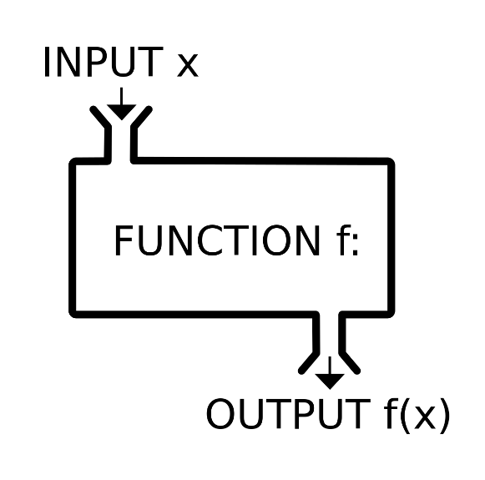

Why Use Functions?
More manageable programming
Splits large problems into small pieces
Better organization of the program
Improves code readability
Improves code understandability
Avoiding repeating code
Improves code maintainability
Code reusability
Using existing Functions several times
Functions

Slide 7
Declaring Functions
To define a function, use the def keyword:
Variables inside a function are local to the function
Function Name
Parameters
def get_product(num1, num2):
return num1 * num2
Function Body
def get_product(num1, num2):
result = num1 * num2
return result
Local Variable

Slide 8
Invoking a Function
Functions are first declared, then invoked (many times)
Functions can be invoked (called) by their name + ():
def print_header():
print("----------")
Function Declaration
Function Invocation
print_header()

Slide 9
Invoking a Function (2)
A Function can be invoked from everywhere in the scope, where it’s defined:
From another Function
In its own body - recursion
def print_header():
print_header_top()
print_header_bottom()
def crash():
crash()

Slide 10
Problem: Blank Receipt
Create a Function that prints a blank cash receipt:
CASH RECEIPT
------------------------------
Header
Charged to____________________
Received by___________________
Body
------------------------------
© SoftUni
Footer
Check your solution here: https://judge.softuni.bg/Contests/Practice/Index/417#0

Slide 11
Solution: Blank Receipt
Create 3 Functions to print each section (header + body + footer)
Copy the content from the slide
For the copyright sign use the Unicode "\u00A9"
Create a Function print_receipt() that calls these 3 Functions:
Check your solution here: https://judge.softuni.bg/Contests/Practice/Index/417#0

Slide 12
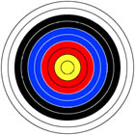
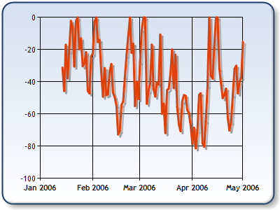
Functions with Parameters
int
float
float
list
int

Slide 13
Function Parameters
Function parameters can be of any data type
Call the Function with certain values (arguments)
Accept parameters
start and end
Multiple parameters separated by comma
def print_numbers(start, end):
for i in range(start, end + 1):
print(i, end=' ')
Passing arguments at invocation
print_numbers(5, 10)

Slide 14
Function Parameters (2)
You can pass zero or several parameters
You can pass parameters of different types
Each parameter has name
Multiple parameters of different types
Parameter name
def print_student(name, age, grade):
print(f"Student: {name}; Age: {age}, Grade: {grade}")

Slide 15
Problem: Sign of Integer Number
Create a Function that prints the sign of an integer number n:
2
The number 2 is positive.
-5
The number -5 is negative.
0
The number 0 is zero.
Check your solution here: https://judge.softuni.bg/Contests/Practice/Index/417#1

Slide 16
Solution: Sign of Integer Number
def print_sign(number):
if number > 0:
print("The number {0} is positive.".format(number))
elif number < 0:
print("The number {0} is negative.".format(number))
else:
print("The number {0} is zero.".format(number))
print_sign(int(input()))
Check your solution here: https://judge.softuni.bg/Contests/Practice/Index/417#1

Slide 17
Optional Parameters
Parameters can accept default values:
The above Function can be called in several ways:
def print_numbers(start = 0, end = 100):
for i in range(start, end + 1):
print(i, end=' ')
Default values
print_numbers(5, 10)
print_numbers(15)
print_numbers()
print_numbers(end=40, start=35)

Slide 18
Problem: Printing Triangle
Create a Function for printing triangles as shown below:
1
1 2
1 2 3
1 2 3 4
1 2 3
1 2
1
1
1 2
1 2 3
1 2
1
3
4
Check your solution here: https://judge.softuni.bg/Contests/Practice/Index/417#2

Slide 19
Solution: Printing Triangle
Create a Function that prints a single line, consisting of numbers from a given start to a given end:
def print_line(start, end):
for i in range(start, end + 1):
print(i, end=' ')
print()
Check your solution here: https://judge.softuni.bg/Contests/Practice/Index/417#2

Slide 20
Solution: Printing Triangle (2)
Create a Function that prints the first half (1..n-1) and then the second half (n…1) of the triangle:
Function with parameter n
def print_triangle(n):
for i in range(1, n):
print_line(1, i)
for i in range(n, 0, -1):
print_line(1, i)
Lines 1...n-1
Lines n…1
Check your solution here: https://judge.softuni.bg/Contests/Practice/Index/417#2

Slide 21
Problem: Draw а Filled Square
Draw at the console a filled square of size n like in the example:
Function with parameter n
--------
-\/\/\/-
-\/\/\/-
--------
def print_header_row(n):
print('-' * 2 * n)
def print_middle_row(n):
print('-', end='')
for i in range(n-1):
print("\\/", end='')
print('-')
4
# TODO: read n
print_header_row(n);
for i in range(n-2):
print_middle_row(n)
print_header_row(n)
Check your solution here: https://judge.softuni.bg/Contests/Practice/Index/417#3

Slide 22
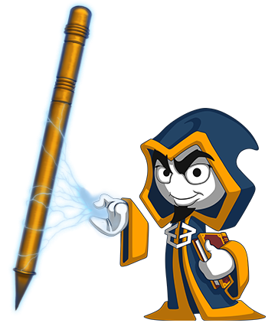
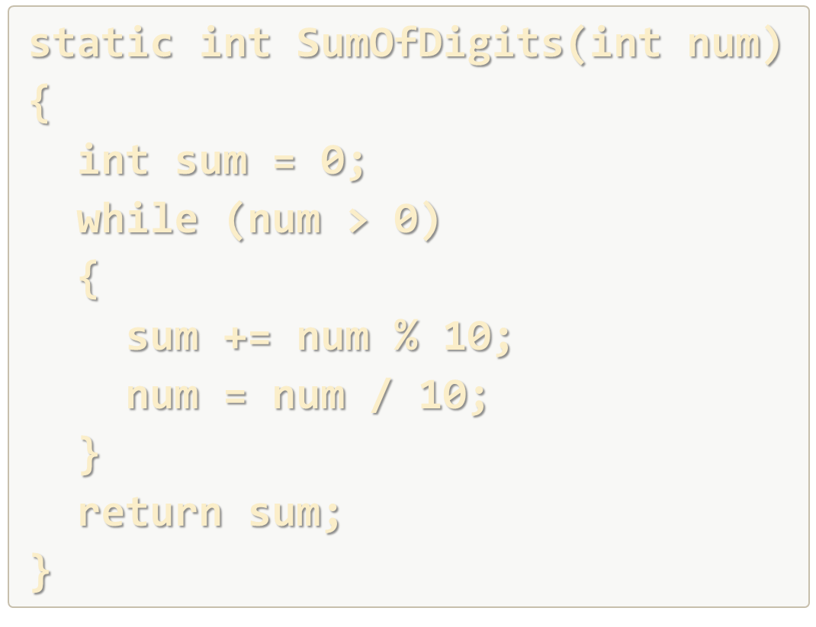
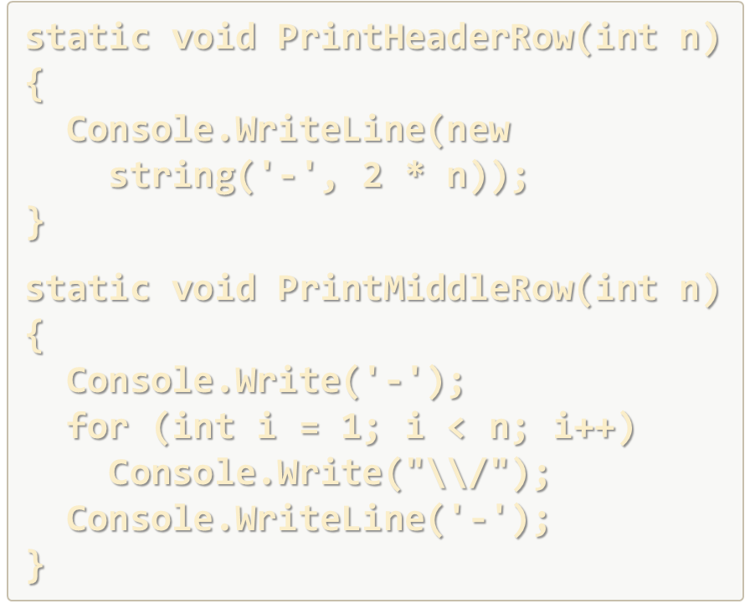
Declaring and Invoking Functions
Live Exercises in Class (Lab)

Slide 23
Returning Values From Functions

Slide 24
The Return Statement
The return keyword immediately stops the Function's execution
Returns the specified value
Functions can be terminated, without returning a value by just using return
def read_full_name():
first_name = input()
last_name = input()
return first_name + " " + last_name
Return a value
def print5():
print(5)
return
print(1)

Slide 25
Using the Return Values
Return value can be:
Assigned to a variable:
Used in expression:
Passed to another Function:
max = get_max(5, 10)
total = get_price() * quantity * 12 / 10
age = int(input())

Slide 26
Temperature Conversion – Example
Convert temperature from Fahrenheit to Celsius:
def fahrenheit_to_celsius(degrees):
celsius = (degrees - 32) * 5 / 9
return celsius
fahrenheit = float(input("Temperature in Fahrenheit: "))
celsius = fahrenheit_to_celsius(fahrenheit)
print(f"Temperature in Celsius: {celsius}")

Slide 27
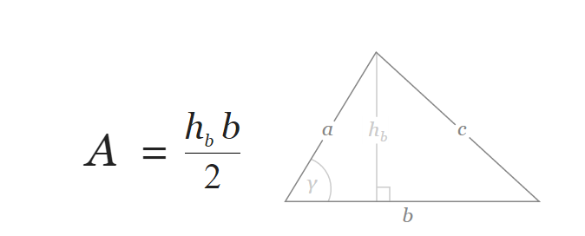
Problem: Calculate Triangle Area
Create a Function that calculates and returns the area of a triangle by given width and height
b = 3
h_{b} = 4
A = 6
Check your solution here: https://judge.softuni.bg/Contests/Practice/Index/417#4

Slide 28
Solution: Calculate Triangle Area
Create a Function with two parameters and a return value:
def calc_triangle_area(side, height):
return side * height / 2
side = float(input())
height = float(input())
print(calc_triangle_area(side, height))
Check your solution here: https://judge.softuni.bg/Contests/Practice/Index/417#4

Slide 29
Problem: Power Function
Create a Function that calculates and returns the value of a number raised to a given power
2⁸
256
3⁴
81
def raise_to_power(number, power):
result = 1;
for i in range(power)
result *= number
return result
Check your solution here: https://judge.softuni.bg/Contests/Practice/Index/417#5

Slide 30
Problem: Greater of Two Values
Create a Function get_max() that returns the greater of two values
int
2
16
16
char
a
z
z
string
aaa
bbb
aaa
Check your solution here: https://judge.softuni.bg/Contests/Practice/Index/417#6

Slide 31
Returning Values and Overloading
Live Exercises in Class (Lab)

Slide 32
Program Execution Flow

Slide 33
Program Execution
The program continues, after a Function execution completes:
def print_logo():
print("Company Logo");
print("http://www.companywebsite.com");
print("before Function executes")
print_logo()
print("after Function executes")
Executes first
Function call
Executes last

Slide 34


Program Execution – Call Stack
"The stack" stores information about the active subroutines (Functions) of a computer program
Keeps track of the point to which each active subroutine should return control when it finishes executing
Call Stack
main()
func_a()
func_b()
call
call
START
main
Function A
Function B
return
return

Slide 35
Problem: Multiply Even by Odd Digits
Create a program that multiplies the sum of all even digits of a number by the sum of all odd digits of the same number:
Create a Function called get_multiple_of_evens_and_odds()
Create a Function get_sum_of_even_digits()
Create get_sum_of_odd_digits()
You may need to use abs() for negative numbers
-12345
Evens: 2 4
Odds: 1 3 5
Even sum: 6
Odd sum: 9
54
Check your solution here: https://judge.softuni.bg/Contests/Practice/Index/417#7

Slide 36
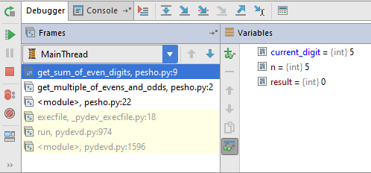

Debugging Code
Using the PyCharm Debugger

Slide 37

Debugging the Code
The process of debugging application includes:
Spotting an error
Finding the lines of code that cause the error
Fixing the error in the code
Testing to check if the error is gone and no new errors are introduced
It’s an iterative and continuous process
Debuggers help a lot. Really!

Slide 38
Debugging in PyCharm debugger
PyCharm has a built-in debugger
It provides:
Breakpoints
Ability to trace the code execution
Ability to inspect variables at runtime

Slide 39
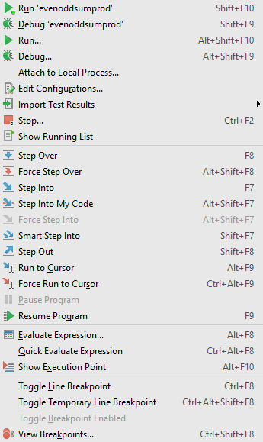
Using PyCharm for debugging
Start without Debugger: [Ctrl+Shift+F10]
Toggle a breakpoint: [Ctrl+F8]
Start with the Debugger: [Alt+Shift+F9]
Trace the program, using the Debugger

Slide 40
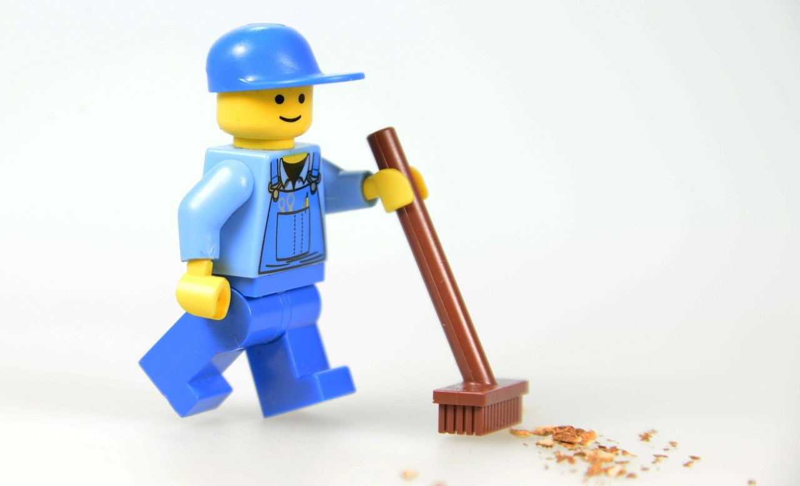
Functions – Naming and Best Practices
Naming
Functions

Slide 41
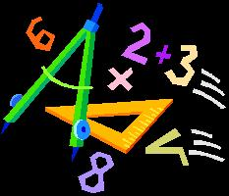


Naming Functions
Functions names:
Should have meaningful names
Should not have capital letters
Should answer the question:
What does this Function do?
If you cannot find a good name for a Function, think about whether it has a clear intent
find_student, load_report, sine
findStudent, loadReport,
function1, do_something, handle_stuff, sampleFunction, dirtyHack

Slide 42
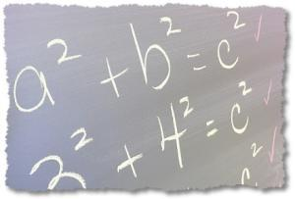
Naming Function Parameters
Function parameter names
Preferred form: [Noun] or [Adjective] + [Noun]
Should not have capital letters (local variables too!)
Should be meaningful
Unit of measure should be obvious
first_name, report, speed, users_list, font_size, font
p, p1, p2, populate, LastName, lastName, convertImage

Slide 43
Functions – Best Practices
Each Function should perform a single, well-defined task
The function's name should describe that task in a clear and unambiguous way
Avoid Functions longer than one screen
Split them to several shorter Functions
def print_receipt():
print_header()
print_body()
print_footer()
Self documenting and easy to test

Slide 44
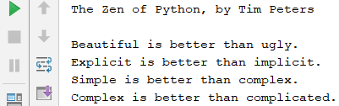
Code Structure and Code Formatting
Formatting guidelines:
Leave 2 blank lines between Functions
Leave one blank line before and after loops and if statements
Avoid long lines and complex expressions
Python mantras:
Beautiful is better than ugly
Simple is better than complex
Readability counts
import this

Slide 45
Debugging and Program Flow
Live Exercises in Class (Lab)

Slide 46
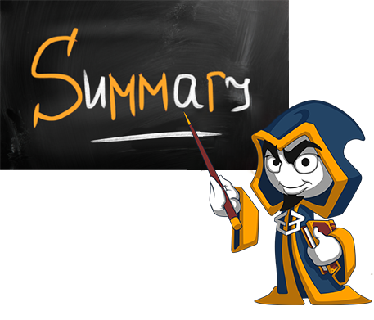
Summary
Break large programs into simple Functions that solve small sub-problems
Functions consist of declaration and body
Functions are invoked by their name + ()
Functions can accept parameters
Parameters take actual values when calling a Function
Functions can return a value or nothing
Debugging helps spotting an error more easily

Slide 47







Functions, Debugging and Troubleshooting
https://softuni.bg/opencourses/python-fundamentals-course

Slide 48

License
This course (slides, examples, demos, videos, homework, etc.) is licensed under the "Creative Commons Attribution-NonCommercial-ShareAlike 4.0 International" license
Attribution: this work may contain portions from
"Fundamentals of Computer Programming with C#" book by Svetlin Nakov & Co. under CC-BY-SA license
Icons from http://www.flaticon.com/ (credits: Freepik, Madebyoliver)

Slide 49




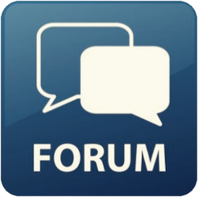
Trainings @ Software University (SoftUni)
Software University – High-Quality Education, Profession and Job for Software Developers
softuni.bg
Software University Foundation
http://softuni.foundation/
Software University @ Facebook
facebook.com/SoftwareUniversity
Software University Forums
forum.softuni.bg

